Slide 1
International Competitiveness and Ex-ante Treatment Effects of CPEC on Household Welfare in Pakistan
Present by:
Lubna Naz

Slide 2
Agreements Boost Economic Activity
Agreements
PTA
FTA
CU
CM

Slide 3
Introduction
Pakistan has signed many bilateral trade agreements with its regional trading partners such as
FTA with Sri Lanka (2005)
PTA with Iran (2004) and Mauritius (2007)
FTA with China (2006) and recently joined Shanghai cooperation Organization
Pakistan and China signed an agreement called Pak-China Economic corridor (CPEC), a one belt and one route’
It would increase integration , employment opportunities, industrial competitiveness and welfare of the households working in industries
International/industrial competitiveness refers to the “overall economic performance”

Slide 4
Introduction
Competitiveness is associated with the ability to achieve higher market share (Krugman, 1986; Spencer and Brandner, 2008; Lall, 2001)
There is a growing debate in exploring the impact of 3218 km long “China Pakistan Economic Corridor” on Pakistan’s economy.
This huge economic corridor is expected to bring economic prosperity, enhanced trade & regional connectivity, infrastructure development etc in the country.

Slide 5
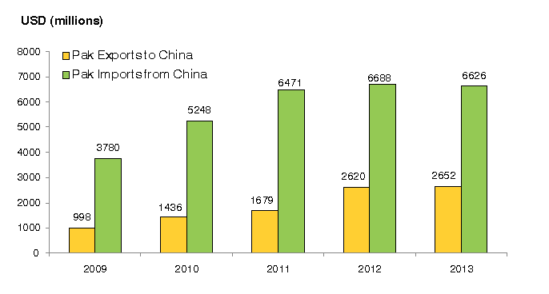
Pak-China Bilateral Trade

Slide 6
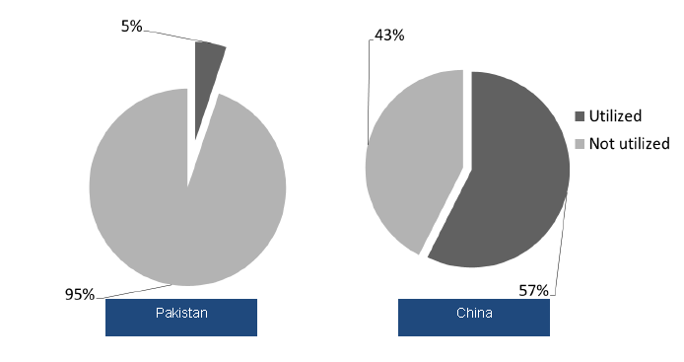
Figure: Pak-China Market Share

Slide 7
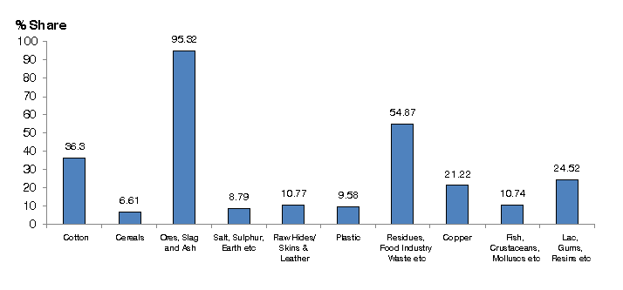
Figure: Export to China as % of Pakistan’s Total Exports 2013

Slide 8
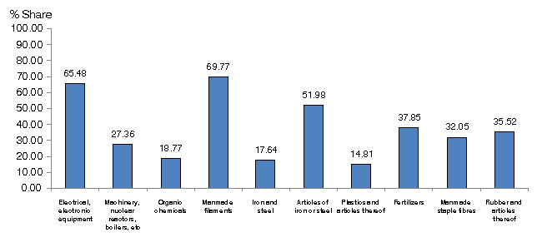
Figure: Imports from China as % of Pakistan total Imports

Slide 9
Objectives of the Study
First direct Microeconometric study (Oliver & Simon, 2006; Micro & Macro) of the impact of competitive industries on household welfare
Firstly, it measures the industrial competitiveness of Agricultural and non-agricultural industries (manufacturing) using revealed comparative advantage (RCA) approach
Secondly it assesses the welfare of those households associated with these industries using semi-parametric propensity score matching (PSM) technique.
Propensity score matching technique (PSM) is used to find the causal effects in observational (non-randomized) studies

Slide 10
Data Sources
Primary Source: Micro data
Pakistan Social and Living Standard Measurement survey (PSLM) 2013-14
Secondary Source: Macro data
United Nations Commodity trade (UNComtrade) database
Sample size: 3445 households of Pakistan and
94 industries (Agriculture & Manufacturing)

Slide 11
Figure: RCA Agriculture Sector by Industry

Slide 12
Figure: RCA Manufacturing Sector by Industry

Slide 13
Results
The positive and statistically significant ATT coefficient of industrial competitiveness
On average household welfare increases by [(e^{0.046}– 1) = 4.6%]
it can be concluded that assessment of ex ante treatment effects of recently signed Pak-China agreement
would also increase employment opportunities
would lead to industrial competitiveness and
Hence economic growth in Pakistan.

Slide 14
Thank you

