Slide 1
China-Pakistan Economic Corridor(CPEC)

Slide 2
Fundamentals of Economic Growth & Development
Growth and Development depends on several economic and demographic factors, however among all these are some common indicators
Infrastructure
  Roads Networks
  Communication
  Energy
Regional Integration
Innovation and Technological Progress

Slide 3
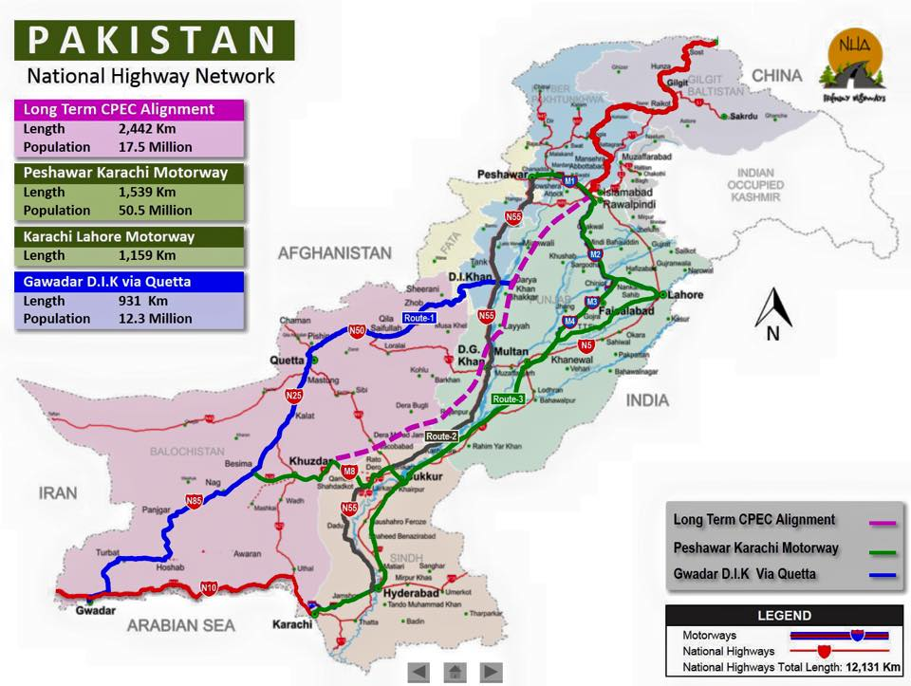
The Eastern Route(Route1) • Gwadar-Turbat-Panjgur-Khuzdar2 -Ratodero-Kashmore-Rajanpur-Dera Ghazi Khan-Multan-FaisalAbad- Rawalpindi- Hasanabdal-and onwards.
Central Route(route2): Gwadar-Turbat-Panjgur-Khuzdar2 -Ratodero-Kashmore-Rajanpur-Dera Ghazi Khan- Dera Ismail Khan-Bannu-Kohat-Peshawar-Hasanabdal-and onwards.
Western-Route (Route1) Gwadar-Turbat-Panjgur-Khuzdar-Kalat-Quetta-Zhob-Dera Ismail KhanBannu-Kohat-Peshawar-Hasanabdal-and onwards.

Slide 4
Socio Economic Profile of CPEC Routes: An Ex-ante Analysis

Slide 5
Ex-ante analysis of C.P.E.C
The motive of this presentation is to highlight and answer one of the most debated question regarding the corridor routes.
I tried to find the best route on the basis of most deprived region
Another prime objective of my research is to provide a base-line for measuring the inclusiveness of CPEC.

Slide 6
Data Description
Literacy Rate
Population aged 10 years and older that can read and write with understanding in any language expressed as percentage of total population aged 10 years and older.
Primary Net Enrolment Rate
Number of children attending primary level (classes 1-5) aged 5-9 years divided by children aged 5-9 years multiplied by 100.
Fully Immunized
Children aged 12-23 months who reported having received full immunization who also have an immunization card, expressed as a percentage of all children aged 12-23 months. To be classified as fully immunized a child must have received: ’BCG’, DPT1, DPT2, DPT3, polio1, polio2, polio3 and Measles.
Diarrhea
Children less than 5 years who suffered from diarrhea in the last 30 days expressed as percentage of all children aged less than 5 years.
Access to Improve Water
Percentage of population has access to improve water is the sum of tap water, hand pump and motor pump.
Access to sanitation
percentage of population access to sanitation in terms of toilet (Flush or Non-flush)

Slide 7
Literacy Rate-Population 10 Years And Older
Route | District | 2004-05 | 2008-09 | 2012-13
E | Rawalpindi | 75 | 79 | 82
w | Quetta | 65 | 67 | 70
E | FaisalAbad | 58 | 61 | 69
WC | Peshawar | 48 | 53 | 59
WEC | Attock | 61 | 61 | 68
WC | Kohat | 47 | 49 | 54
E | Multan | 48 | 56 | 60
E | Gwadar | 38 | 61 | 56
WC | Bannu | 40 | 49 | 48
EC | Larkana/Ratodaro | 38 | 53 | 54
WEC | Ketch | 48 | 52 | 48
WEC | Khuzdar | 29 | 46 | 46
E | Dera Ghazi Khan | 41 | 41 | 45
W | Kalat | 33 | 42 | 45
WC | Dera Ismail Khan | 38 | 39 | 37
EC | Kashmore | NA | 43 | 39
EC | Rajanpur | 40 | 27 | 39
W | Zhob | 25 | 41 | 33
WEC | Panjgur | 28 | 49 | 0
Literacy Rate-Population 10 Years And Older
 |  | 2004-05 | 2008-09 | 2012-13
Average | Eastern Route | 45.82 | 52.42 | 50.50
Average | Central Route | 41.70 | 47.36 | 44.73
Average | Western Route | 46.20 | 49.82 | 46.18
Source: Pakistan Social and Living standard Measurement Survey(PSLM 2004-05, 08-09 & 12-13

Slide 8
Literacy Rate-Population 10 Years And Older
Routs | 2004-05 | 2008-09 | 2012-13 | Poorest on the basis of average of 2013
Eastern Route | 45.82 | 52.42 | 50.50 | Central Route
Central Route | 41.70 | 47.36 | 44.73
Western Route | 46.20 | 49.82 | 46.18

Slide 9
NET ENROLMENT RATE AT THE PRIMARY LEVEL (AGE 5-9)- (EXCLUDING KATCHI CLASS)
Routs | 2004-05 | 2008-09 | 2012-13 | Poorest on the basis of average of 2013
Eastern Route | 50.91 | 57.67 | 54.75 | Central & Western Route
Central Route | 46.00 | 53.00 | 49.00
Western Route | 48.10 | 51.64 | 49.18

Slide 10
PERCENTAGE OF CHILDREN AGED 12-23 MONTHS THAT HAVE BEEN IMMUNISED
Routs | 2004-05 | 2008-09 | 2012-13 | Poorest on the basis of average of 2013
Eastern Route | 46.55 | 38.83 | 43.00 | Western Route
Central Route | 40.80 | 38.00 | 39.91
Western Route | 43.00 | 35.45 | 38.64

Slide 11
Children Under 5 Suffering From Diarrhea In Past 30 Days
Routs | 2004-05 | 2008-09 | 2012-13 | Poorest on the basis of average of 2013
Eastern Route | 19.55 | 8.75 | 10.92 | Central Route
Central Route | 18.60 | 7.27 | 12.00
Western Route | 17.40 | 6.55 | 11.45

Slide 12
Percent Distribution Of Households Toilet Facilities (Having Flush )
Routs | 2004-05 | 2008-09 | 2012-13 | Poorest on the basis of average of 2013
Eastern Route | 45.55 | 45.58 | 49.92 | Western Route
Central Route | 41.40 | 42.45 | 48.73
Western Route | 42.90 | 43.82 | 47.27

Slide 13
Percentage Distribution Of Household By Source Of Drinking Water -Access to Water
Routs | 2004-05 | 2008-09 | 2012-13 | Poorest on the basis of average of 2013
Eastern Route | 70.00 | 76.00 | 73.00 | Western Route
Central Route | 70.00 | 76.00 | 74.00
Western Route | 63.00 | 64.00 | 66.00

Slide 14
Socio-Economic Profile of Chinese counter Part Region- Xinjiang
Source: National Bureau of Statistics of China(NBS)

Slide 15
Source: National Bureau of Statistics of China(NBS)

Slide 16
Source: National Bureau of Statistics of China(NBS)

Slide 17
Conclusion and Further Research Requirements
No. | Summary | Most Deprived Route
1 | Literacy Rate-Population 10 Years And Older | Central Route
2 | NET ENROLMENT RATE AT THE PRIMARY LEVEL (AGE 5-9)- (EXCLUDING KATCHI CLASS) | Central & Western Route
3 | PERCENTAGE OF CHILDREN AGED 12-23 MONTHS THAT HAVE BEEN IMMUNISED | Western Route
4 | Children Under 5 Suffering From Diarrhea In Past 30 Days | Central Route
5 | Percent Distribution Of Households Toilet Facilities (Having Flush ) | Western Route
6 | Percentage Distribution Of Household By Source Of Drinking Water -Access to Water | Western Route

Slide 18
Cont………
For measuring the inclusiveness of the China Pakistan Economics Corridor(CPEC) an Ex-post study of these connected regions is required.
An ex-post study is also required to compare the demographic improvement between Pakistani regions and Chinese regions which are connected with the CPEC route.

Slide 19
Cont………
For further research I would request to our guest that kindly share the availability and access of micro-level data (English Version) of following Chinese data sets
Household living standard measurement survey (stata or SPSS files)
Houshold Income and expenditure survey
Labour force survey data

Slide 20
Thanking You

